Slide 1
Correspondence Analysis
David Mukajanga

Slide 2
What is it?
It is a type of analysis that analyzes the nature of values in groups of one variable depending on how they are distributed in groups of another one.
It is a method primarly used to create perception maps that show which group of a certain variable is attracted to what group of another variable.
Say for example you are a communication device manufacturer producing smartphones, cellphones and pagers. Correspondence analysis will enable you to create a visual map of which segment of the population consumes which device more.

Slide 3
The Example
 | Cellphones | Pagers | Smartphones | Total
Students | 60 | 10 | 80 | 150
Workers | 30 | 79 | 42 | 151
Elderly People | 96 | 11 | 22 | 129
Total | 186 | 100 | 144 | 430

Slide 4
What are Your Goals
In this analysis:
You want to analyze how heavy each group in the columns and/or the rows takes compared to other groups in the same column or row
You want to create dimensions in which these groups will be measured upon.
You want to analyze the impact of the dimensions to the groups and vice versa.
The process to achieving the first objective is quite simple: You can just check by the eye which group had the highest mark in the particular row or column.
To achieve the same goal more analytically, just take the value in each cell of that particular row / column and divide it by its total. The answer is the percent of the cell to the total of the row/column in decimals.

Slide 5
2nd Objective:
For the second objective, you have to go through the following hoops:
Calculating the Expected Value of each Row
Calculating the Chi-Square of the values in Each Row
Calculating The Similarity Values of Each Row
Calculating The Inertia Values of Each Row

Slide 6
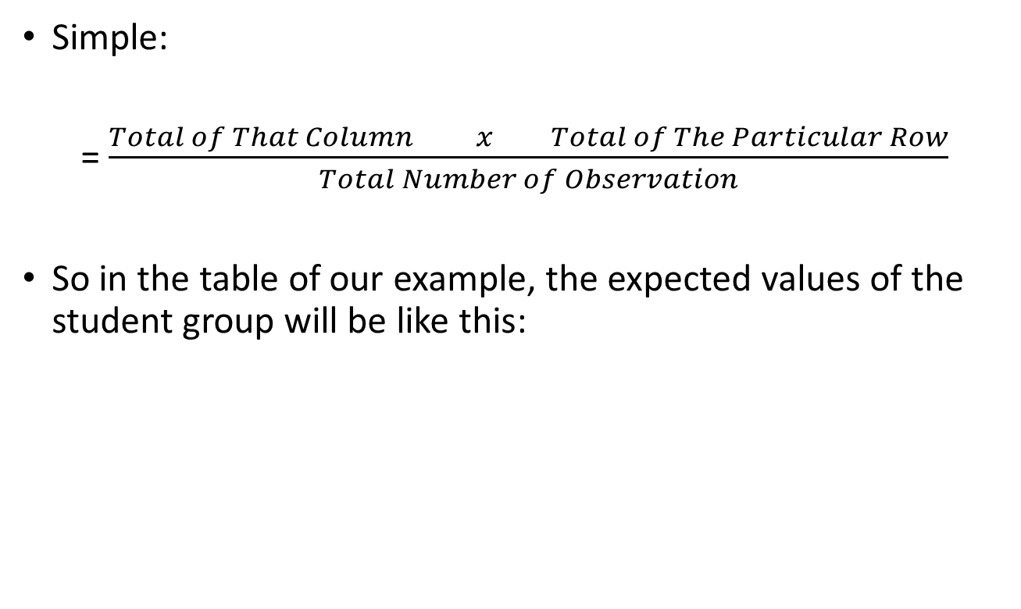
2.1: Getting The Expected Values
Simple:
= $\frac{Total of That Column x Total of The Particular Row}{Total Number of Observation}$
So in the table of our example, the expected values of the student group will be like this:
 | Cellphones | Pagers | Smrtphns | Total
Observed Values | 60 | 10 | 80 | 150
Column Total | 186 | 100 | 144 | 430
Expected Values | (186*150)/430 | (100*150)/430 | (144*150)/ 430

